Slide 1

Chapter 4
Digital Transmission

Slide 2
Digital Transmission
The Information needs to be converted to either a digital signal or an analog signal for transmission
Conversion methods
Digital/Digital encoding
Analog/Digital encoding
Digital/Analog encoding
Analog/Analog encoding
Unipolar
Polar
Bipolar
PCM
DM
ASK
FSK
PSK
AM
FM
PM
Multilevel
Multitransition
QAM

Slide 3
4.1 DIGITAL-TO-DIGITAL CONVERSION
In this section, we see how we can represent digital data by using digital signals. The conversion involves three techniques: line coding, block coding, and scrambling. Line coding is always needed; block coding and scrambling may or may not be needed.
Topics discussed in this section:
Line Coding
Line Coding Schemes
Block Coding
Scrambling

Slide 4

Digital-to-Digital Conversion
Converts sequence of bits to a digital signal
Figure 4.1 Line coding and decoding

Slide 5
Characteristics of Line Coding
Signal element vs. data element
Data rate vs. bit rate
dc components
Self-synchronization

Slide 6
Data element versus Signal element
Data element – the smallest entity that can represent a piece of information : this is the bit.
Signal element – carries data element. A signal element is the shortest unit of a digital signal.
Data elements are being carried; signal elements are the carriers.

Slide 7

Data element versus Signal element
Figure 4.2 Signal element versus data element

Slide 8
Data Rate versus Signal Rate
Data rate (bit rate) : the No. of data elements sent in 1s.(bps)
Signal rate (pulse rate, modulation rate or baud rate) :
- the number of signal elements sent in 1s.(baud)
Relationship between Data rate Vs Signal rate
S = c x N x 1/r (baud)
where S : No. of signal element, (baud)
c : case factor,
N : Data rate (bps),
r : No. of data elements carried by each signal element.

Slide 9

Data Rate versus Signal Rate
Example 4.1
A signal is carrying data in which one data element is encoded as one signal element ( r = 1). If the bit rate is 100 kbps, what is the average value of the baud rate if c is between 0 and 1?
Solution
We assume that the average value of c is 1/2 . The baud rate is then

Slide 10

Bandwidth
Note
Although the actual bandwidth of a digital signal is infinite, the effective bandwidth is finite.
* A digital signal that carries information is nonperiodic. So, bandwidth of nonperiodic signal is continuous with an infinite range theoretically.

Slide 11
Min. Bandwidth & Max. Data rate
The baud rate determines the required bandwidth for a digital signal.
Minimum bandwidth
B_{minimum} = c x N x 1/r
Maximum Data rate
N_{maximum} = (1/c) x B x r

Slide 12

Min. Bandwidth & Max. Data rate
Example 4.2
The maximum data rate of a channel (see Chapter 3) is N_{max} = 2 × B × log₂ L (defined by the Nyquist formula). Does this agree with the previous formula for N_{max}?
Solution
A signal with L levels actually can carry log₂L bits per level. If each level corresponds to one signal element and we assume the average case (c = 1/2), then we have

Slide 13
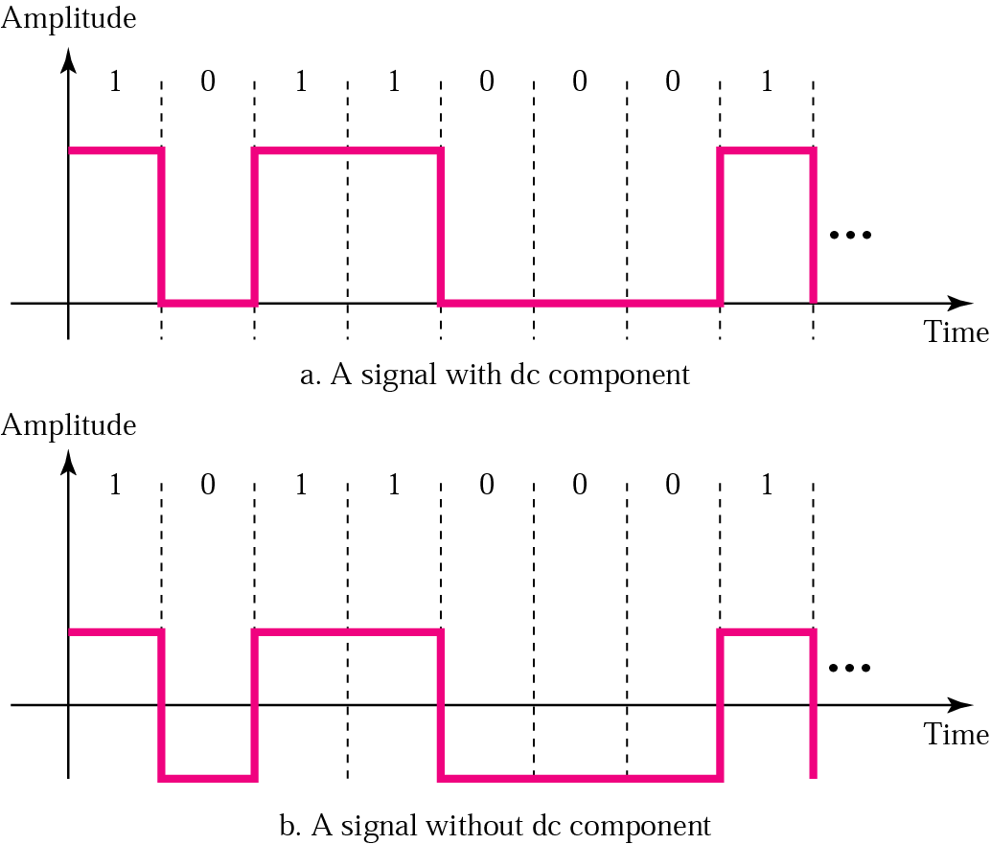
DC Components
Some systems (such as transformer) will not allow passage of DC component
DC Component is just extra energy on the line, but useless

Slide 14
Self-Synchronization
Receiver’s bit intervals must correspond exactly to the sender’s bit intervals
Self-synchronizing signal includes timing information
If the receiver’s clock is out of synchronization, these alerting points can reset the clock.

Slide 15

Self-Synchronization
Figure 4.3 Effect of lack of synchronization

Slide 16
Self-Synchronization
Example 4.3
In a digital transmission, the receiver clock is 0.1 percent faster than the sender clock. How many extra bits per second does the receiver receive if the data rate is
1 kbps? How many if the data rate is 1 Mbps?
Solution
At 1 kbps, the receiver receives 1001 bps instead of 1000 bps.
At 1 Mbps, the receiver receives 1,001,000 bps instead of 1,000,000 bps.

Slide 17

Line Coding Schemes

Slide 18

Line Coding Schemes
Figure 4.5 Unipolar NRZ scheme
Unipolar encoding uses only one voltage level.

Slide 19
Unipolar encoding disadvantages
DC component
No synchronization

Slide 20
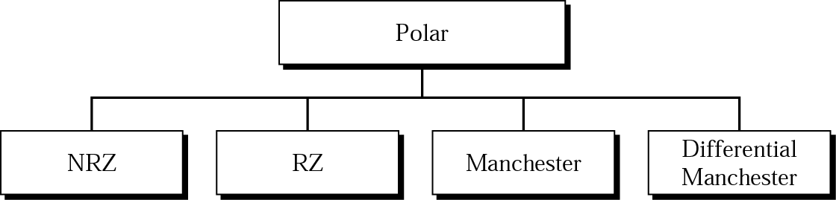
Variations of Polar Schemes

Slide 21
Polar Schemes
Polar encoding uses two voltage levels
(positive and negative).

Slide 22

NRZ-L and NRZ-I
In Non-return to Zero-level (NRZ-L) the level of the signal is dependent upon the state of the bit.
In Non-return to Zero-Invert (NRZ-I) the signal is inverted if a 1 is encountered.
Figure 4.6 Polar NRZ-L and NRZ-I schemes

Slide 23
Note
In NRZ-L the level of the voltage determines the value of the bit.
In NRZ-I the inversion
or the lack of inversion
determines the value of the bit.

Slide 24
Note
NRZ-L and NRZ-I both have an average signal rate of N/2 Bd.

Slide 25
Note
NRZ-L and NRZ-I both have a DC component problem.

Slide 26
Example 4.4
A system is using NRZ-I to transfer 1 Mbps data. What are the average signal rate and minimum bandwidth?
Solution
The average signal rate is S = N/2 = 500 kbaud. The minimum bandwidth for this average baud rate is B_{min} = S = 500 kHz.

Slide 27

RZ (Return-to-zero)
Figure 4.7 Polar RZ scheme
A good encoded digital signal must contain a provision for synchronization.

Slide 28

Biphase: Manchester & Differential Manchester
Figure 4.8 Polar biphase: Manchester and differential Manchester schemes

Slide 29
Biphase: Manchester & Differential Manchester
In Manchester and differential Manchester encoding, the transition
at the middle of the bit is used for synchronization.
The minimum bandwidth of Manchester and differential Manchester is 2 times that of NRZ.

Slide 30

Bipolar Schemes
In bipolar encoding, we use three levels:
- positive, zero, and negative.
Bipolar schemes: AMI and pseudoternary

Slide 31
Multilevel Schemes
The desire to increase the data speed or decrease the required bandwidth has resulted in the creation of many scheme.
The goal is to increase the number of bits per baud by encoding a pattern of m data elements into a pattern of n signal elements.
In mBnL schemes, a pattern of m data elements is encoded as a pattern of n signal elements in which 2^{m} ≤ L^{n}.

Slide 32

Multilevel Schemes (cont’d)
Figure 4.10 Multilevel: 2B1Q scheme

Slide 33

Multilevel Schemes (cont’d)
Figure 4.11 Multilevel: 8B6T scheme

Slide 34

Multilevel Schemes (cont’d)
Figure 4.12 Multilevel: 4D-PAM5 scheme
_{Mbps)}
_{Mbps)}
_{Mbps)}
_{Mbps)}

Slide 35

Multiline Transmission
Figure 4.13 Multitransition: MLT-3 scheme

Slide 36


Summary of line coding schemes
Table 4.1 Summary of line coding schemes

Slide 37
4.2 Block Coding
We need redundancy to endure synchronization and to provide some kind of inherent error detecting.
Block coding can give us redundancy to endure Synchronization and improve the performance of line coding.
Block coding is normally referred to as mB/nB coding;
it replaces each m-bit group with an
n-bit group.

Slide 38

Block Coding (cont’d)
Steps in transmission
  Step 1: Division
    divide sequence of bits into groups of m bits
  Step 2: Substitution
    substitute an m-bit code for an n-bit group
  Step 3: Line Coding
    create the signal

Slide 39

Block Coding (cont’d)
Figure 4.14 Block coding concept

Slide 40

Block Coding (cont’d)
Figure 4.15 Using block coding 4B/5B with NRZ-I line coding scheme

Slide 41

Block Coding (cont’d)
Figure 4.16 Substitution in 4B/5B block coding

Slide 42
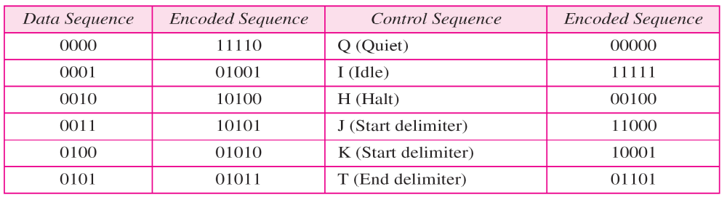

Block Coding (cont’d)
Table 4.2 4B/5B mapping codes

Slide 43

Block Coding (cont’d)
Figure 4.17 8B/10B block encoding

Slide 44
Scrambling
Biphase and the other scheme are not suitable for long-distance communication because of their wide bandwidth requirement and DC component.
Scrambling substitutes long zero-level pulses with a combination of other levels to provide synchronization.
Two common scrambling techniques are B8ZS and HDB3.

Slide 45

Scrambling (cont’d)
Figure 4.18 AMI used with scrambling

Slide 46

Scrambling (cont’d)
Figure 4.19 Two cases of B8ZS scrambling technique
B8ZS substitutes eight consecutive zeros with 000VB0VB.

Slide 47

Scrambling (cont’d)
Figure 4.20 Different situations in HDB3 scrambling technique
HDB3 substitutes four consecutive zeros with 000V or B00V depending on the number of nonzero pulses after the last substitution.

Slide 48
4.2 ANALOG-TO-DIGITAL CONVERSION
We have seen in Chapter 3 that a digital signal is superior to an analog signal. The tendency today is to change an analog signal to digital data. In this section we describe two techniques, pulse code modulation and delta modulation.
Topics discussed in this section:
Pulse Code Modulation (PCM)
Delta Modulation (DM)

Slide 49

Pulse Code Modulation (PCM)
To change an analog signal to digital data (digitization) is called Pulse Code Modulation (PCM)
Figure 4.21 Components of PCM encoder

Slide 50
Sampling
Pulse amplitude modulation has some applications, but it is not used by itself in data communication. However, it is the first step in another very popular conversion method called pulse code modulation.
Term sampling means measuring the amplitude of the signal
at equal intervals.

Slide 51

Sampling (cont’d)
Figure 4.22 Three different sampling methods for PCM

Slide 52
Sampling (cont’d)
Note
According to the Nyquist theorem, the sampling rate must be
at least 2 times the highest frequency contained in the signal.

Slide 53

Sampling (cont’d)
Figure 4.23 Nyquist sampling rate for low-pass and bandpass signals

Slide 54
Sampling (cont’d)
Example 4.6
For an intuitive example of the Nyquist theorem, let us sample a simple sine wave at three sampling rates: f_{s} = 4f (2 times the Nyquist rate), f_{s} = 2f (Nyquist rate), and
f_{s} = f (one-half the Nyquist rate). Figure 4.24 shows the sampling and the subsequent recovery of the signal.
It can be seen that sampling at the Nyquist rate can create a good approximation of the original sine wave (part a). Oversampling in part b can also create the same approximation, but it is redundant and unnecessary. Sampling below the Nyquist rate (part c) does not produce a signal that looks like the original sine wave.

Slide 55

Sampling (cont’d)
Figure 4.24 Recovery of a sampled sine wave for different sampling rates

Slide 56
Sampling (cont’d)
Example 4.9
Telephone companies digitize voice by assuming a maximum frequency of 4000 Hz. The sampling rate therefore is 8000 samples per second.

Slide 57
Sampling (cont’d)
Example 4.10
A complex low-pass signal has a bandwidth of 200 kHz. What is the minimum sampling rate for this signal?
Solution
The bandwidth of a low-pass signal is between 0 and f, where f is the maximum frequency in the signal. Therefore, we can sample this signal at 2 times the highest frequency (200 kHz). The sampling rate is therefore 400,000 samples per second.

Slide 58
Sampling (cont’d)
Example 4.9
Telephone companies digitize voice by assuming a maximum frequency of 4000 Hz. The sampling rate therefore is 8000 samples per second.

Slide 59
Sampling (cont’d)
Example 4.10
A complex low-pass signal has a bandwidth of 200 kHz. What is the minimum sampling rate for this signal?
Solution
The bandwidth of a low-pass signal is between 0 and f, where f is the maximum frequency in the signal. Therefore, we can sample this signal at 2 times the highest frequency (200 kHz). The sampling rate is therefore 400,000 samples per second.

Slide 60
Sampling (cont’d)
Example 4.11
A complex bandpass signal has a bandwidth of 200 kHz. What is the minimum sampling rate for this signal?
Solution
We cannot find the minimum sampling rate in this case because we do not know where the bandwidth starts or ends. We do not know the maximum frequency in the signal.

Slide 61
Quantization
The result of sampling is a series of pulses with amplitude values between the max. and min. amplitudes of the signal.
These values cannot be used in the encoding process.
The following are the steps in quantization:
  Assume the original analog signal has instantaneous amplitudes between V_{min.} and V_{max.}
  Divide the range into L zones, each of height Δ (delta)
  Δ = (V_{min.} - V_{max}.) / L
  Assign quantized values of 0 to L-1 to the midpoint of each zone
  Approximate the value of the sample amplitude to the quantized values.
Quantization Error
SNR_{dB} = 6.02n_{b} + 1.76 dB

Slide 62

Quantization (cont’d)
Figure 4.26 Quantization and encoding of a sampled signal

Slide 63
Quantization (cont’d)
Example 4.12
What is the SNR_{dB} in the example of Figure 4.26?
Solution
We can use the formula to find the quantization. We have eight levels and 3 bits per sample, so
SNR_{dB} = 6.02(3) + 1.76 = 19.82 dB
Increasing the number of levels increases the SNR.

Slide 64
Quantization (cont’d)
Example 4.13
A telephone subscriber line must have an SNR_{dB} above 40. What is the minimum number of bits per sample?
Solution
We can calculate the number of bits as
Telephone companies usually assign 7 or 8 bits per sample.

Slide 65
Encoding
The last step in PCM is encoding.
After each sample is quantized and the number of bits per sample is decided, each sample can be changed to an n_{b}-bit code word.
Bit Rate Formula
  Bit rate = sampling rate x number of bits per sample = f_{s} x n_{b}
    Where No. of quantization level : L , No. of bits (n_{b} )= log₂ L

Slide 66

Encoding (cont’d)
Example 4.14
We want to digitize the human voice. What is the bit rate, assuming 8 bits per sample?
Solution
The human voice normally contains frequencies from 0 to 4000 Hz. So the sampling rate and bit rate are calculated as follows:

Slide 67

Original Signal Recovery
Figure 4.27 Components of a PCM decoder

Slide 68
PCM Bandwidth
If we digitized the signal, what is the new bandwidth of the channel ?
  B_{min} = c x N x 1/r = c x n_{b} x f_{s} x 1/r = c x n_{b} x 2 B_{analog} x 1/r
The minimum bandwidth
  B_{min} = n_{b} x B_{analog}
The maximum data rate of a Channel
  N_{max} = 2 x B x log ₂ L (bps)
The minimum bandwidth
  B_{min} = N / (2 x log ₂ L) (Hz)

Slide 69
PCM Bandwidth
Example 4.15
We have a low-pass analog signal of 4 kHz. If we send the analog signal, we need a channel with a minimum bandwidth of 4 kHz. If we digitize the signal and send 8 bits per sample, we need a channel with a minimum bandwidth of 8 × 4 kHz = 32 kHz.

Slide 70

Delta Modulation
Delta Modulation (DM) techniques have been developed to reduce the complexity of PCM.
PCM finds the value of the signal amplitude for each sample; DM finds the change from the previous sample.
Figure 4.28 The process of delta modulation

Slide 71

Delta Modulation (cont’d)
Figure 4.29 Delta modulation components

Slide 72

Delta Modulation (cont’d)
Figure 4.30 Delta demodulation components

Slide 73
4.3 TRANSMISSION MODES
The transmission of binary data across a link can be accomplished in either parallel or serial mode. In parallel mode, multiple bits are sent with each clock tick. In serial mode, 1 bit is sent with each clock tick. While there is only one way to send parallel data, there are three subclasses of serial transmission: asynchronous, synchronous, and isochronous.
Topics discussed in this section:
Parallel Transmission
Serial Transmission

Slide 74

Transmission Modes
Figure 4.31 Data transmission and modes

Slide 75

Transmission Modes (cont’d)
Figure 4.32 Parallel transmission

Slide 76

Transmission Modes (cont’d)
Figure 4.33 Serial transmission

Slide 77
Transmission Modes (cont’d)
In asynchronous transmission, we send 1 start bit (0) at the beginning and 1 or more stop bits (1s) at the end of each byte. There may be a gap between
each byte.
Asynchronous here means “asynchronous at the byte level,”
but the bits are still synchronized;
their durations are the same.

Slide 78

Transmission Modes (cont’d)
Figure 4.34 Asynchronous transmission

Slide 79
Transmission Modes (cont’d)
In synchronous transmission, we send bits one after another without start or stop bits or gaps. It is the responsibility of the receiver to group the bits.

Slide 80

Transmission Modes (cont’d)
Figure 4.35 Synchronous transmission

Slide 81

Q & A

